Slide 1
Simulating Cosmic Ray Feedback in the Resolved ISM:
Star Formation and Outflows
Brandon Sike (UM), Mateusz Ruszkowski (UM), Christoph Pfrommer (AIP), Timon Thomas (AIP), Matthias Weber (AIP), Peng Oh (UCSB), Oleg Gnedin (UM), Bill Chen (UM). With funding from NSF, ACCESS, NASA, and UM.
Rencontres du Vietnam TMEX 2025, January 8th, 2025

Slide 2
Quick review of galactic feedback

Slide 3
Galactic Feedback (Before Cosmic Rays)
Fountain Flow
Inflow
Outflow
Star Formation
Supernovae

Slide 4
Galactic Feedback (With Cosmic Rays)
Fountain Flow
?
?
Inflow
?
Outflow
+
GeV
Cosmic Rays
?
Star Formation
Supernovae

Slide 5
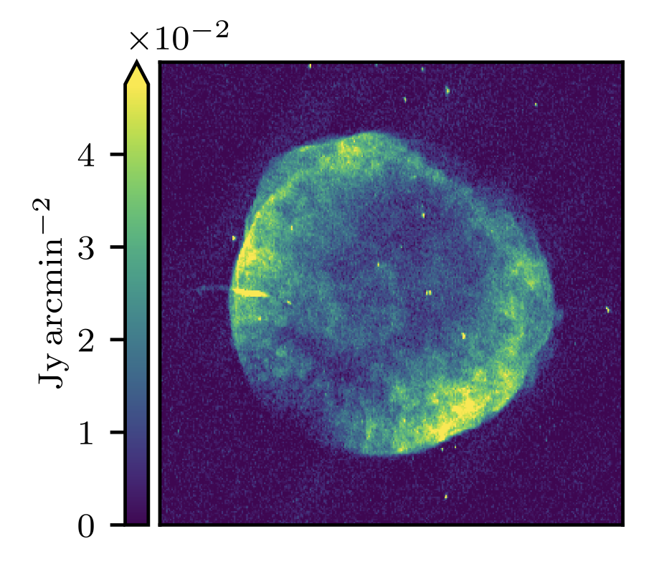
What do I mean by Cosmic Ray (CR)?
SN1006
Relativistic, charged particles found throughout the universe.
Accelerated at shock fronts around supernova remnants.
~GeV protons are dynamically significant, often traced by electrons that are observable in the radio.
Winner et. al. (2019), with data from Dyer et. al. (2009)

Slide 6
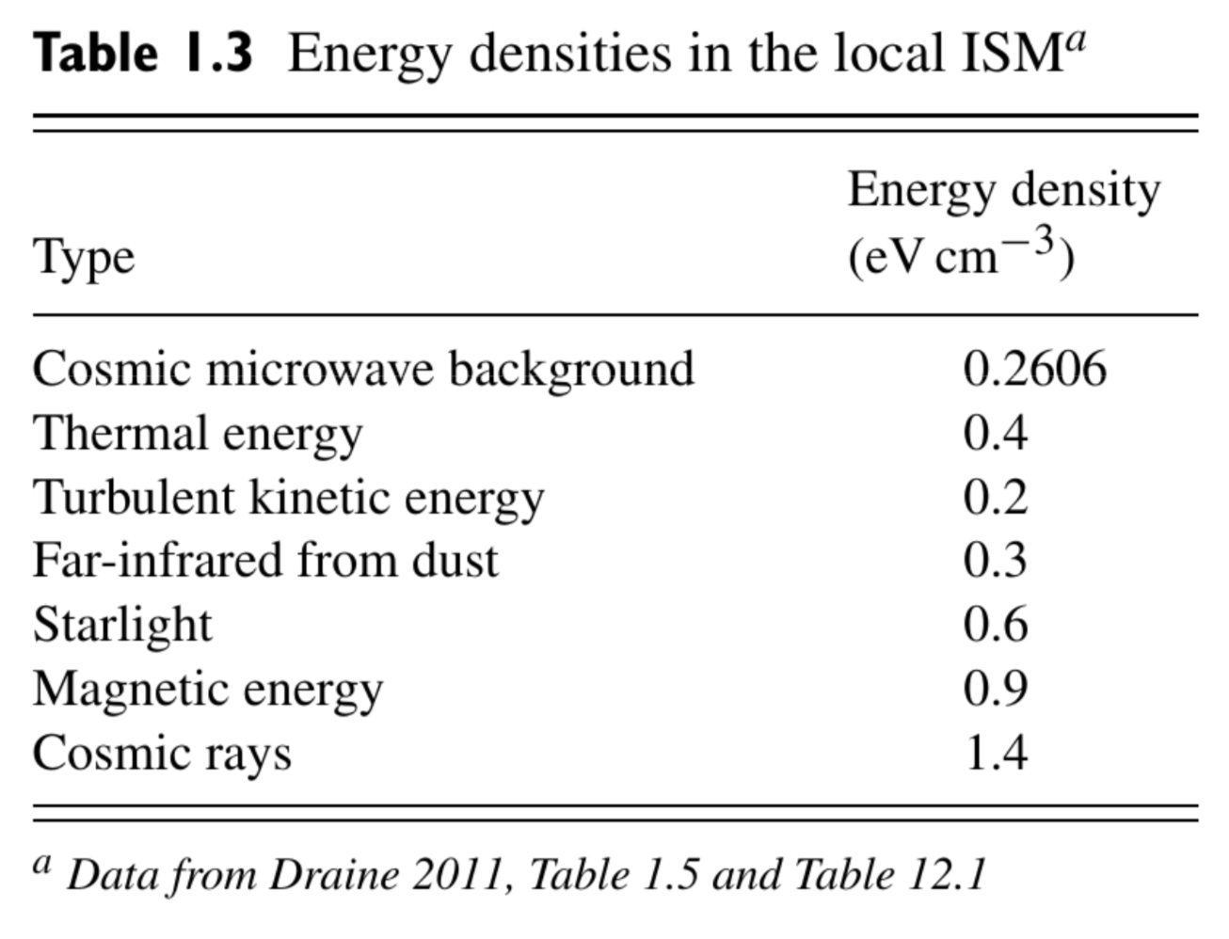
Cosmic Rays in Galaxies
Equipartition with other energy densities in the ISM.
Provide a source of pressure, contribute to heating, drive molecular chemistry, trace magnetic field topology.
Notably, cosmic rays can exchange momentum and energy with the gas over long time and distance scales.
Ryden & Pogge: Interstellar and Intergalactic Medium (2021) with data adapted from Draine (2011), with cosmic ray data from Voyager measurements (Webber & Yushak 1983).

Slide 7
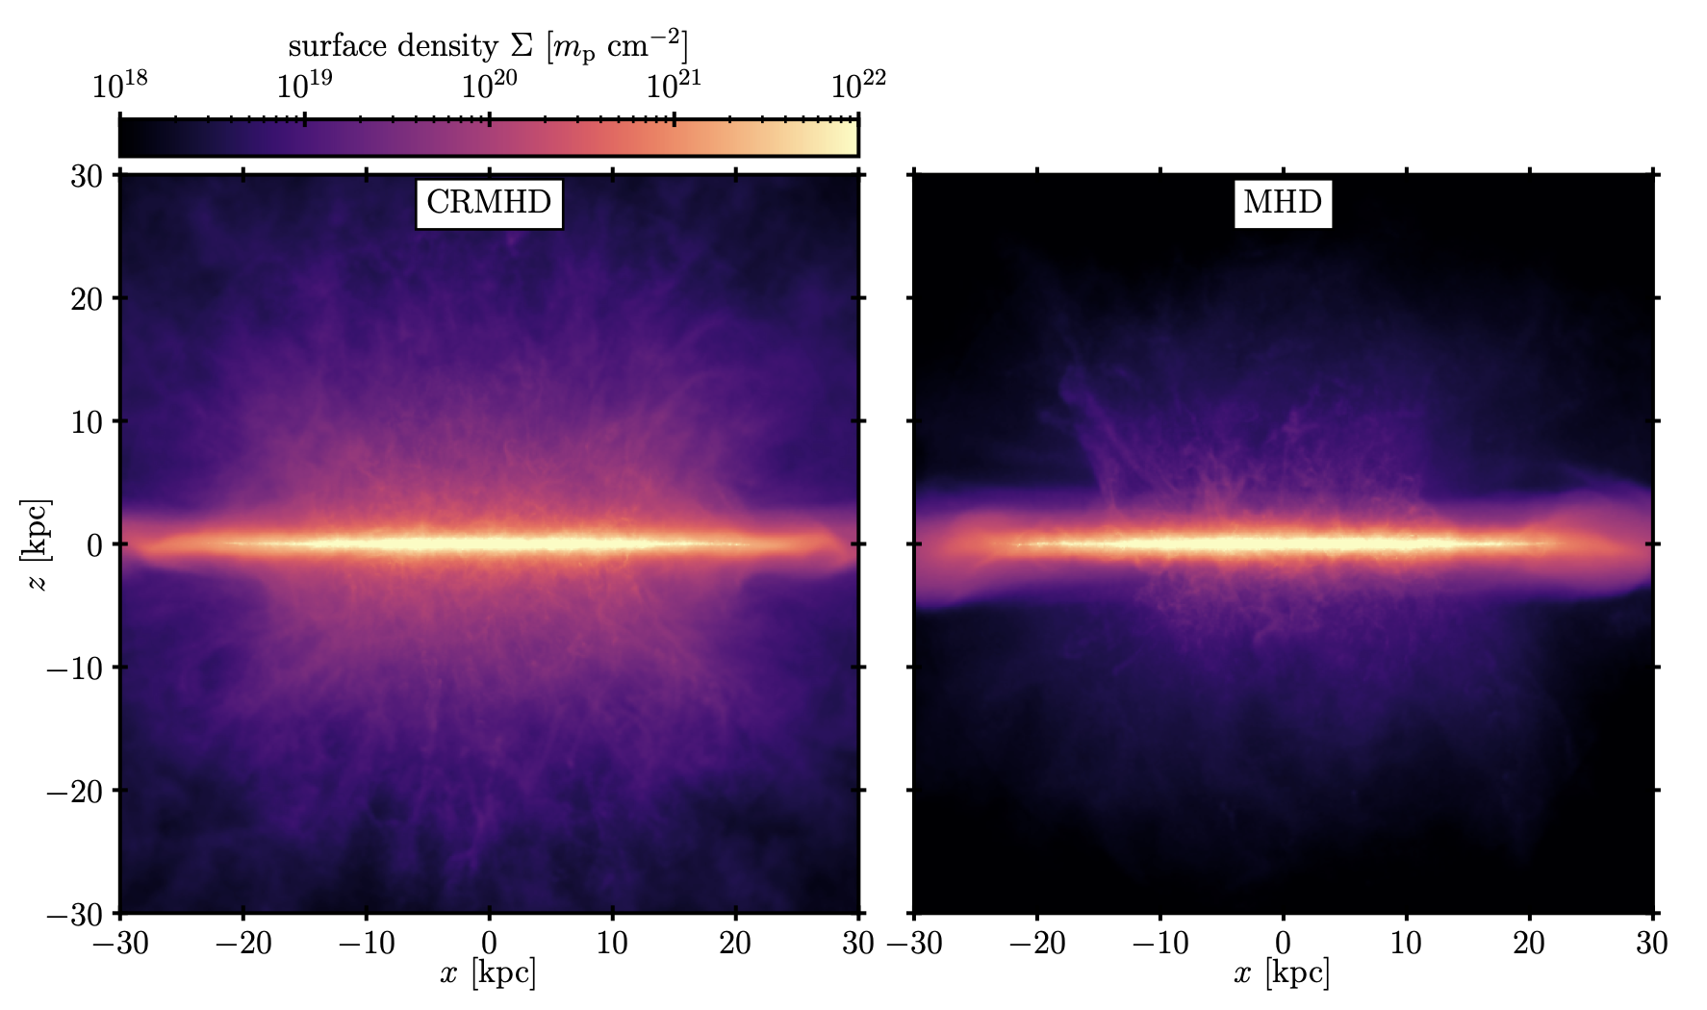
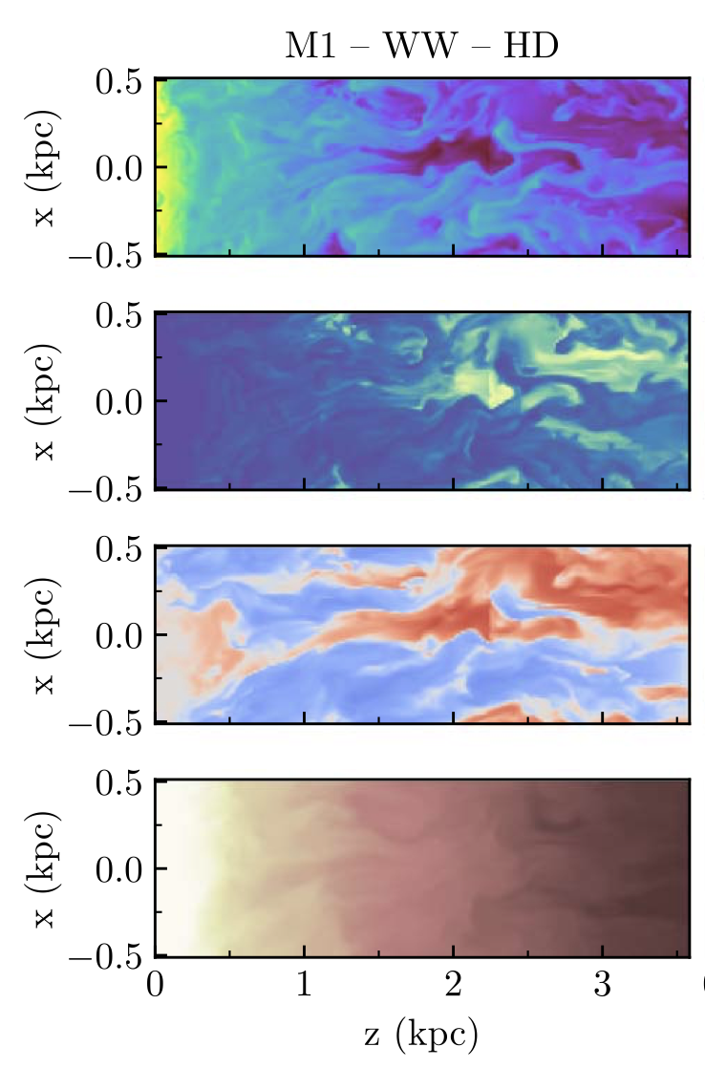
Cosmic Ray-Driven Galactic Winds
CRs drive an outflow by establishing a pressure gradient.
CR-driven winds are able to lift more material into the CGM than thermally-driven winds.
CR Pressure Gradient
Armillotta et al. (2024)
Thomas et al. (2024)

Slide 8
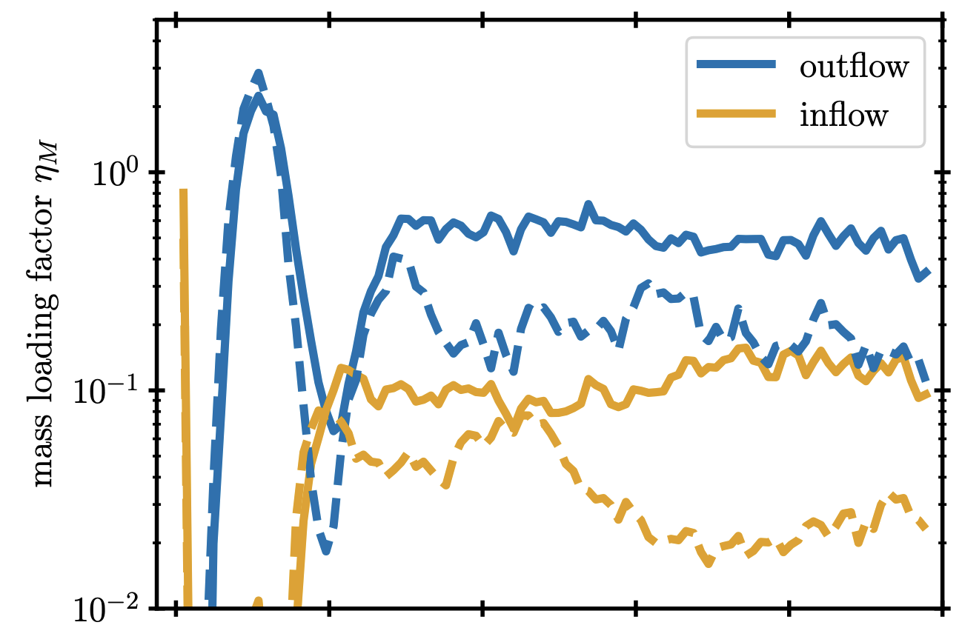
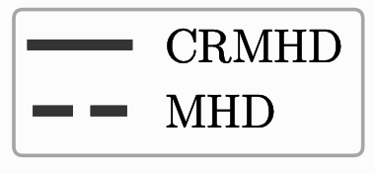
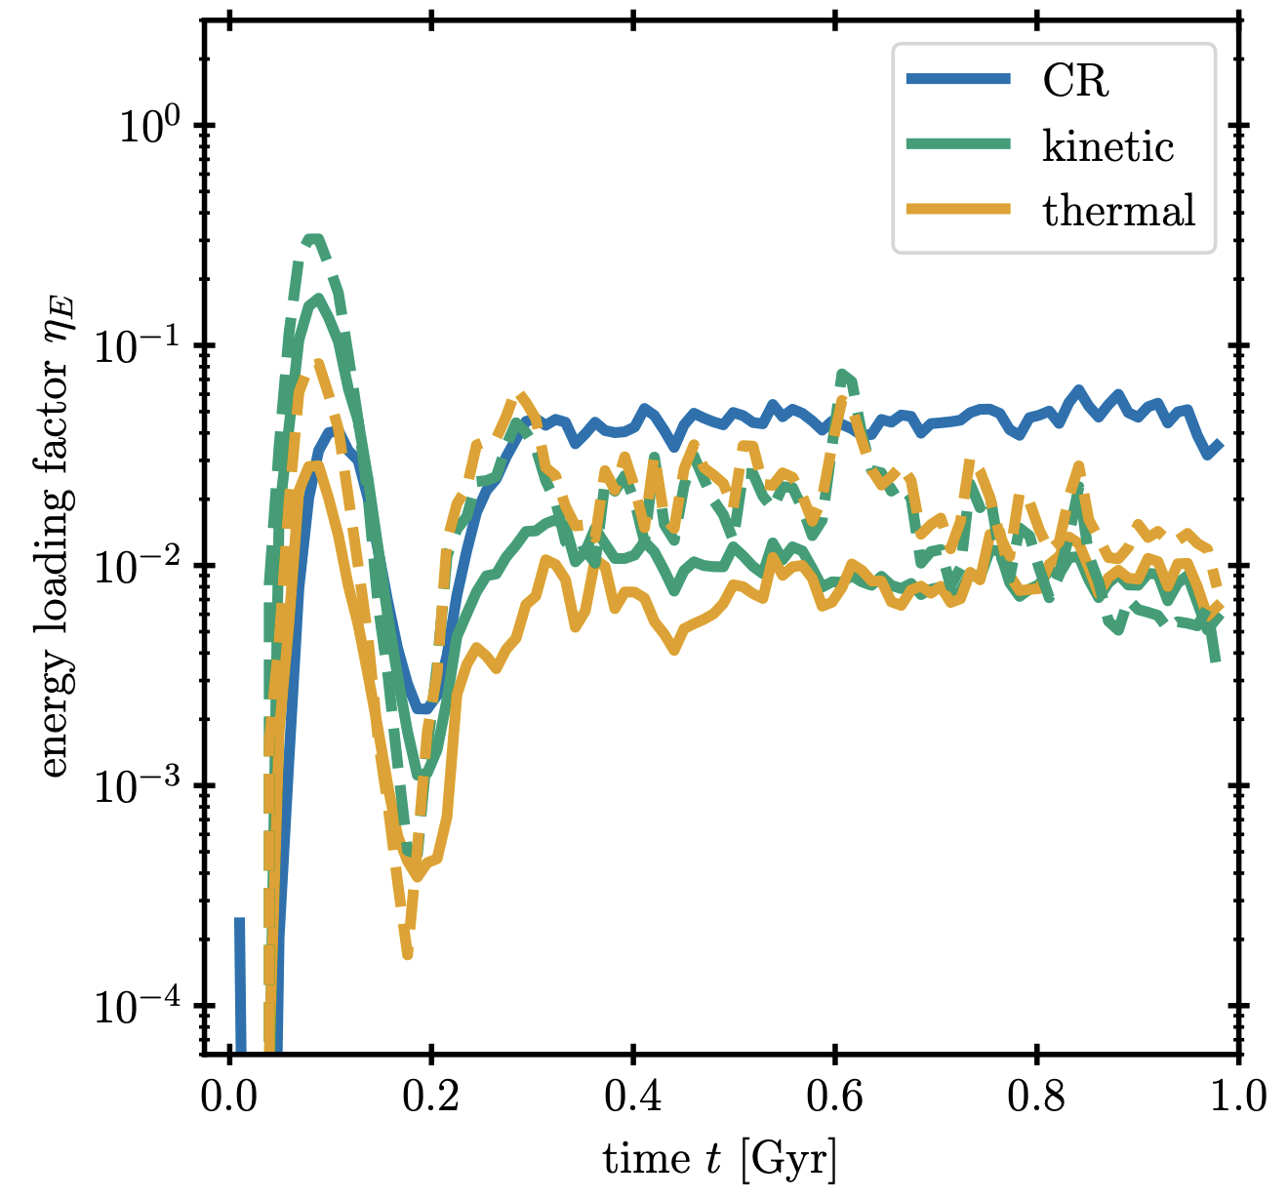
Outflow Diagnostics
Mass and energy loading factors tell us about the efficacy of feedback in driving outflows.
CR-driven winds have higher mass loading factors than pure MHD winds, and also primarily contain energy as CRs.
Thomas et al. (2024)

Slide 9
GeV Cosmic Ray Transport

Slide 10
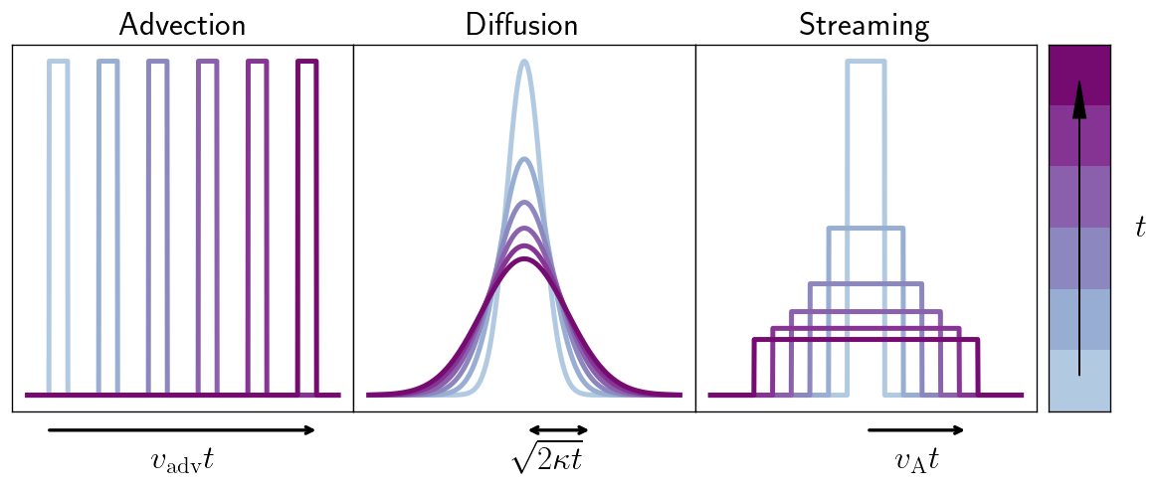
CR Transport
Adapted from Thomas et. al. 2020
Advection, diffusion, and streaming are regulated by magnetic fields and Alfvén waves.
Energy is transported along magnetic fields at
Real CR transport is a combination of these modes.

Slide 11
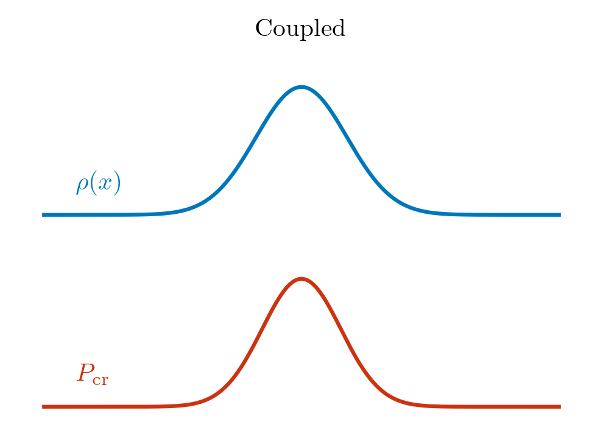
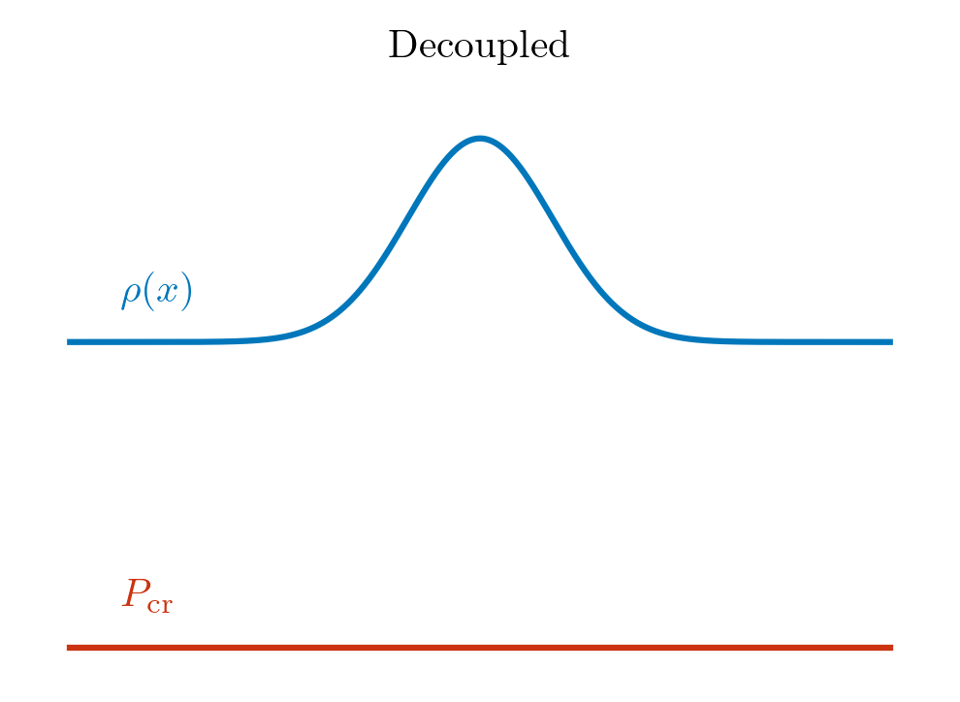
CR Transport: Damping Processes
CRs are confined by Alfvén waves, Alfvén waves are damped.
Nonlinear Landau damping (NLLD) is energy loss from beat waves, sets universal coupling.
Ion neutral damping (IND) is ~frictional loss from ion/neutral collisions, decouples CRs from neutral regions.
Add IND
X

Slide 12
The Questions:
How does CR feedback affect the steady-state SFR and galactic outflow?
How do CRs interact with multiphase gas in the wind?
Does ion-neutral damping prevent CRs from providing effective feedback?

Slide 13
Model

Slide 14
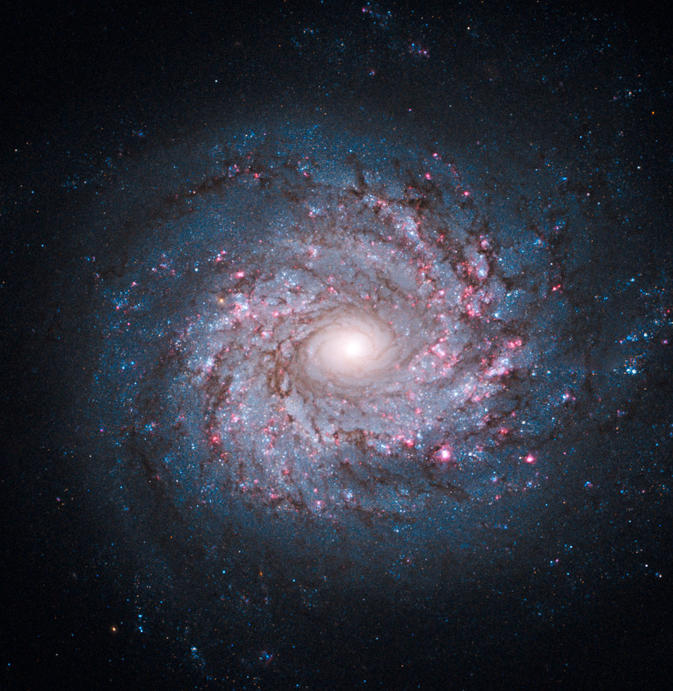
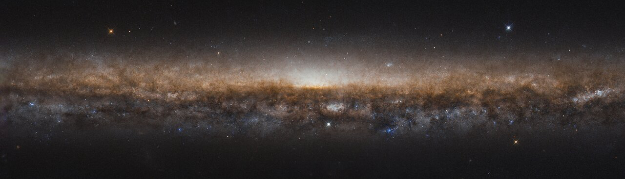
ISM Tallbox
Use AREPO (Springel 2010)
1 kpc * 1 kpc * 8 kpc
Σgas = 10 Msun / pc^2
10 Msun resolution in the ISM
~3 pc resolution in the wind
Live MHD, stellar feedback
Nonequilibrium ionization model CRISP
Face-on spiral galaxy NGC 3982, NASA, ESA, and the Hubble Heritage Team (STScI/AURA)
Edge-on spiral galaxy NGC 5907, ESA/Hubble & NASA, R. de Jong. Acknowledgement: Judy Schmidt (Geckzilla)

Slide 15
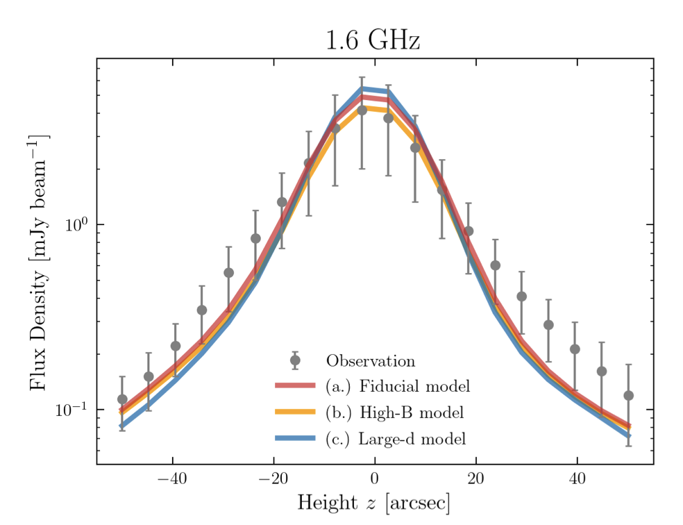
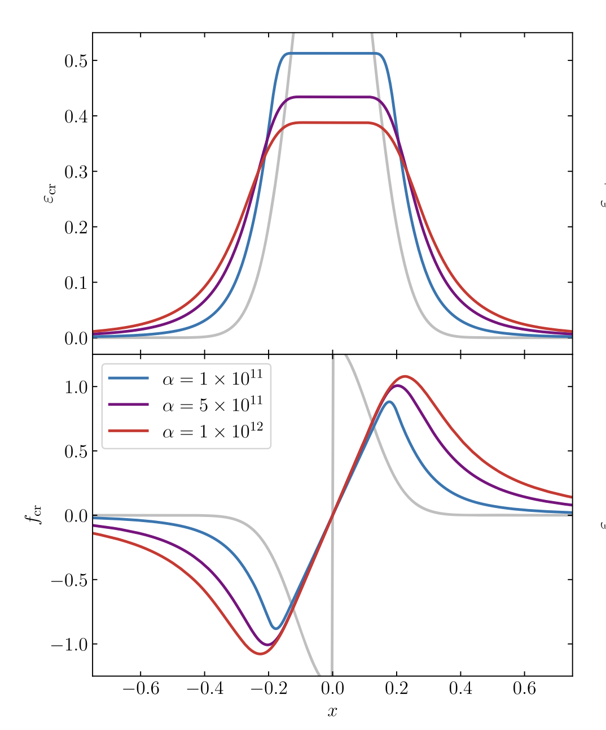
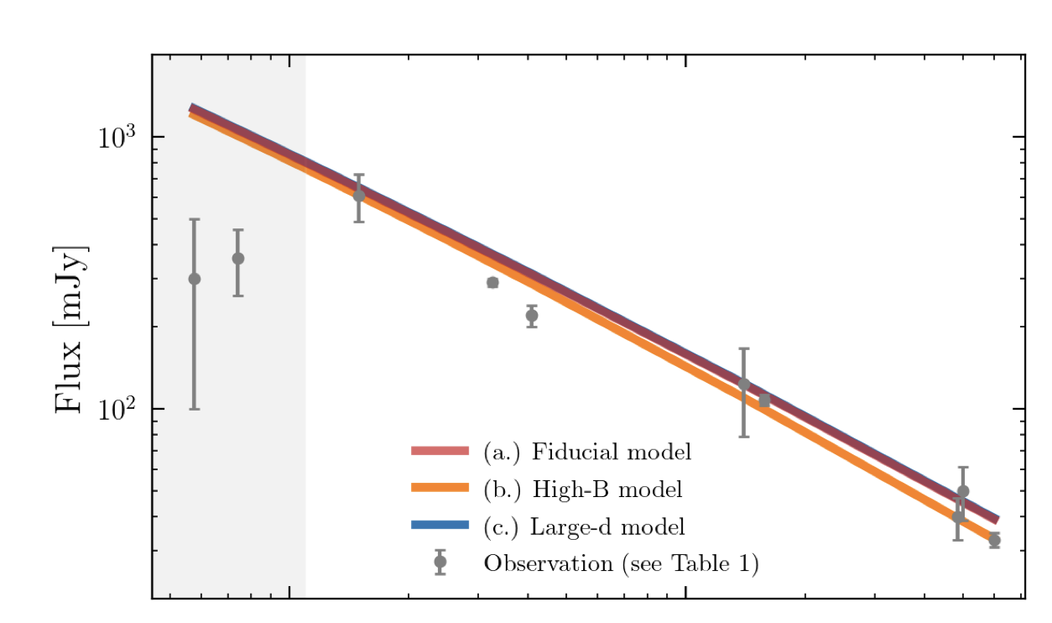
Alfvén-Wave Regulated CRMHD
Thomas & Pfrommer (2019)
Two-moment model which follows advection + streaming + diffusion and both NLLD and IND calculated on-the-fly.
Matches radio observations well.
Thomas & Pfrommer (2019)
Chiu et al. (2024)

Slide 16
4 Cases
(“MHD”): No CRs
(“CR-A”): CRs with only advection
(“CR-NL”): CRs with two-moment CRMHD (advection + streaming + diffusion) and only NLLD. Uniform coupling of CRs to gas.
(“CR-NL-IN”): CRs with two-moment CRMHD (advection + streaming + diffusion) and both NLLD and IND. Full physics; CRs decouple from neutral gas.

Slide 17
Results

Slide 18
Animation

Slide 19
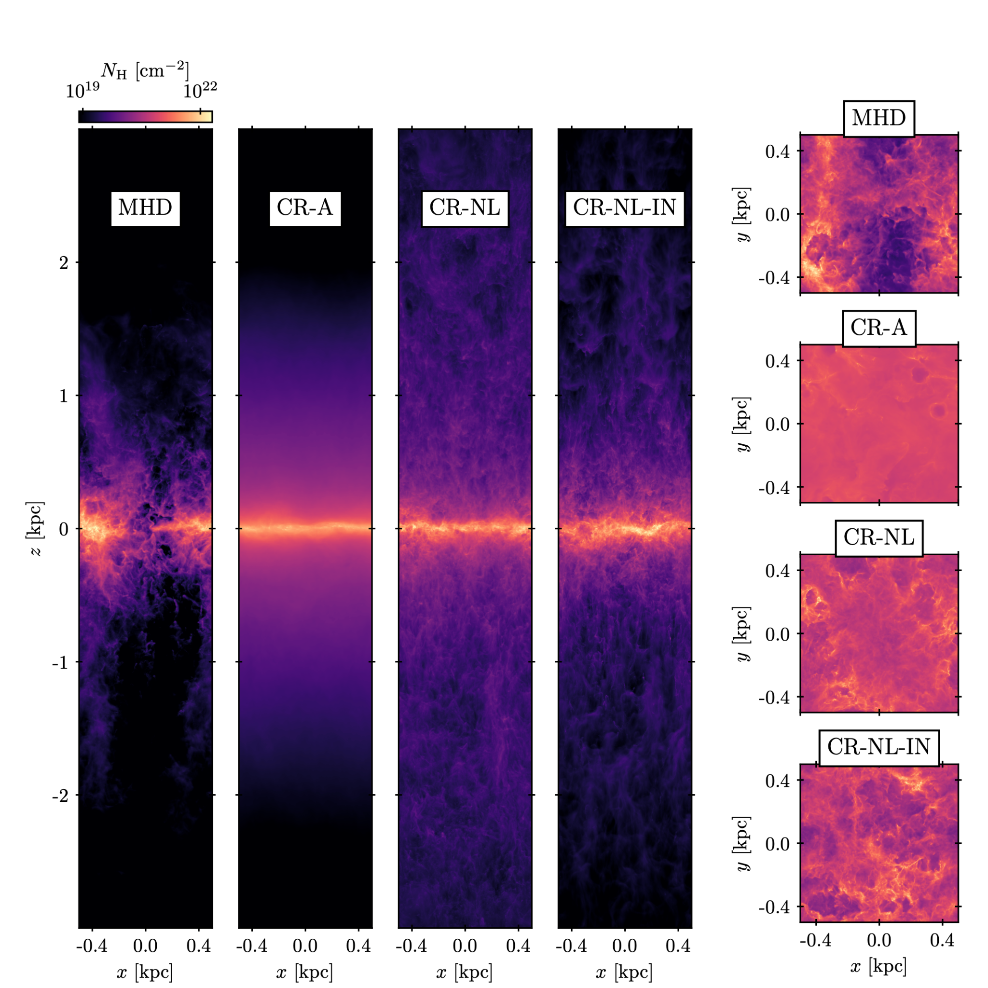
Column Density
CRs cause the wind to display higher column densities.
Pure MHD case has the most visible excavation due to large regions of low-density, SN-heated gas.

Slide 20
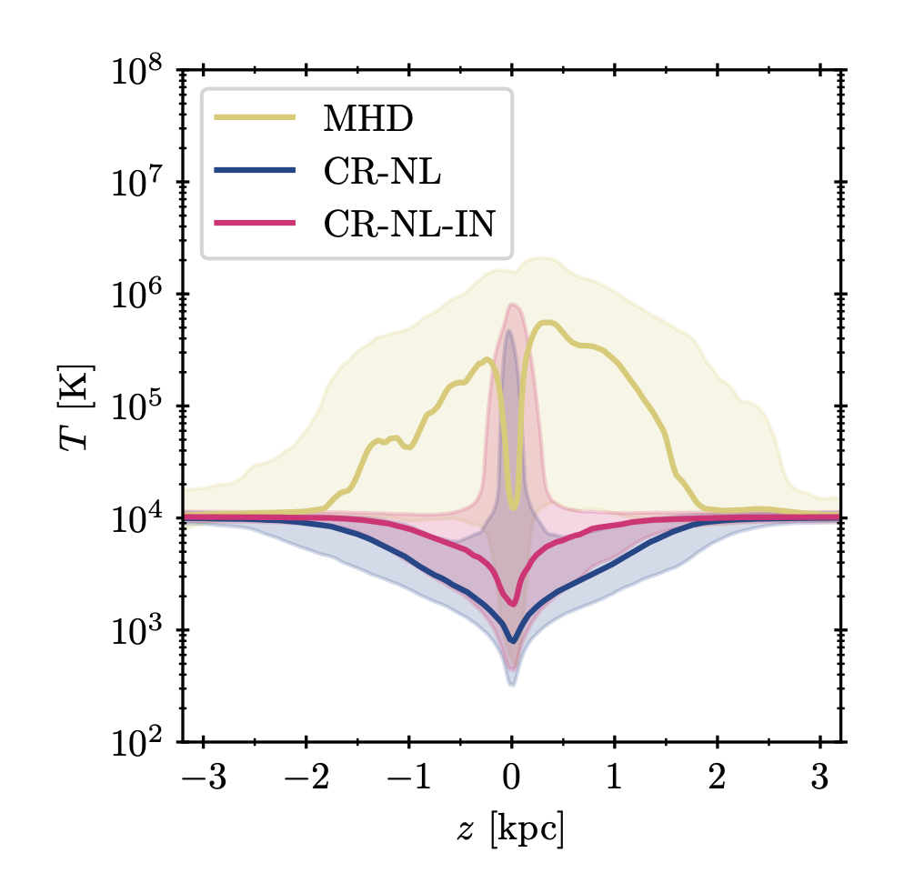
Temperature Profiles
MHD is the hottest; supernovae-driven.
CRs in CR-NL can couple to cold gas in the wind, CRs in CR-NL-IN cannot.
IND makes the wind moderately warmer.

Slide 21
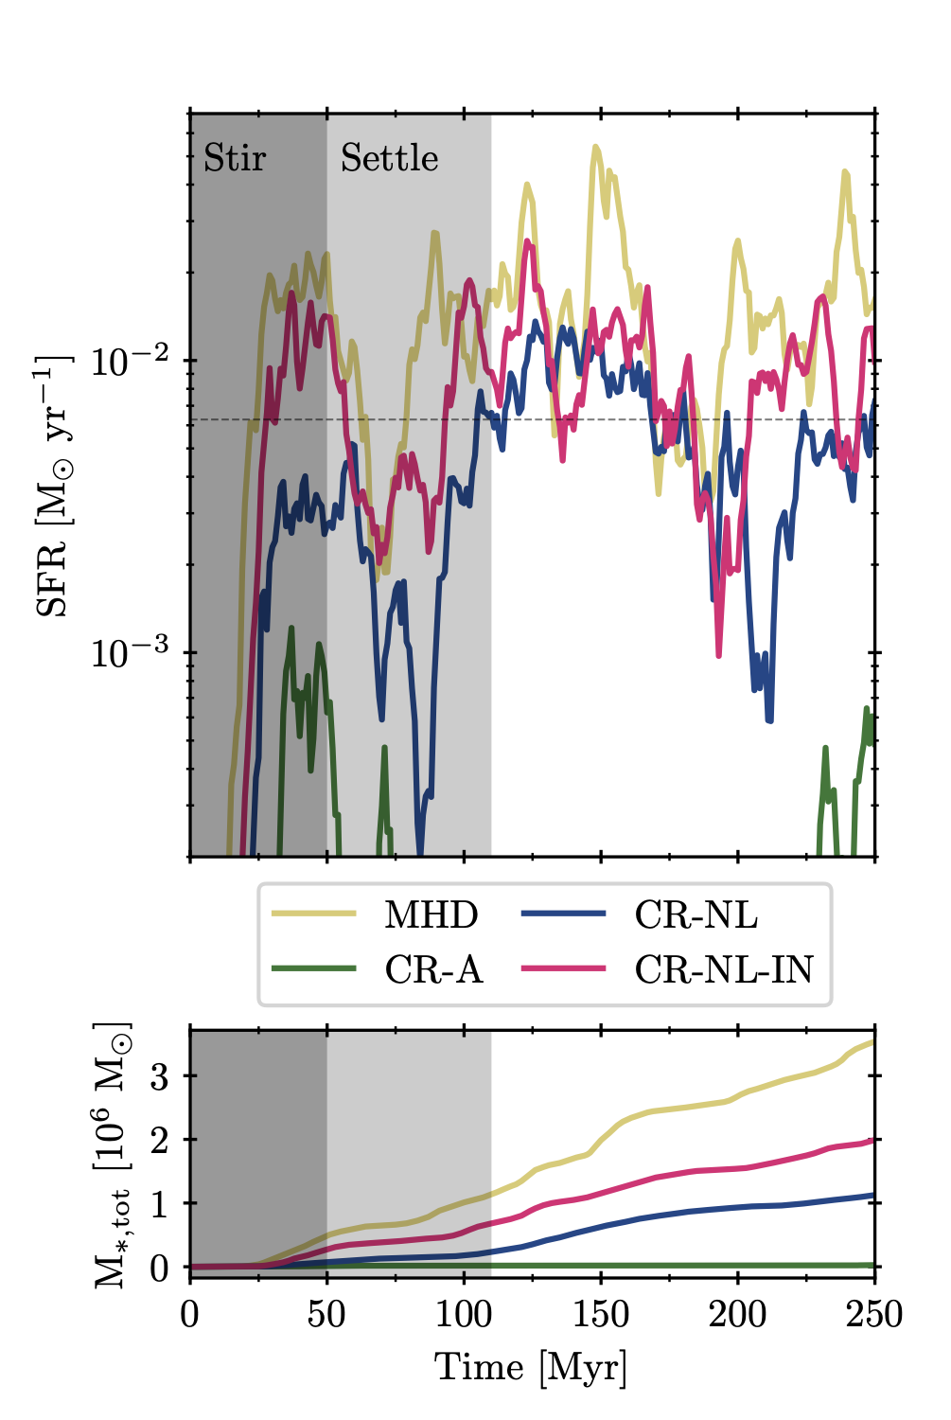
Star Formation Rate
From highest to lowest: MHD, CR-NL-IN, CR-NL, CR-A.
IND reduces the impact of CRs on the SFR.
CRs in CR-A are extremely effective at preventing star formation, so we ignore that case.

Slide 22
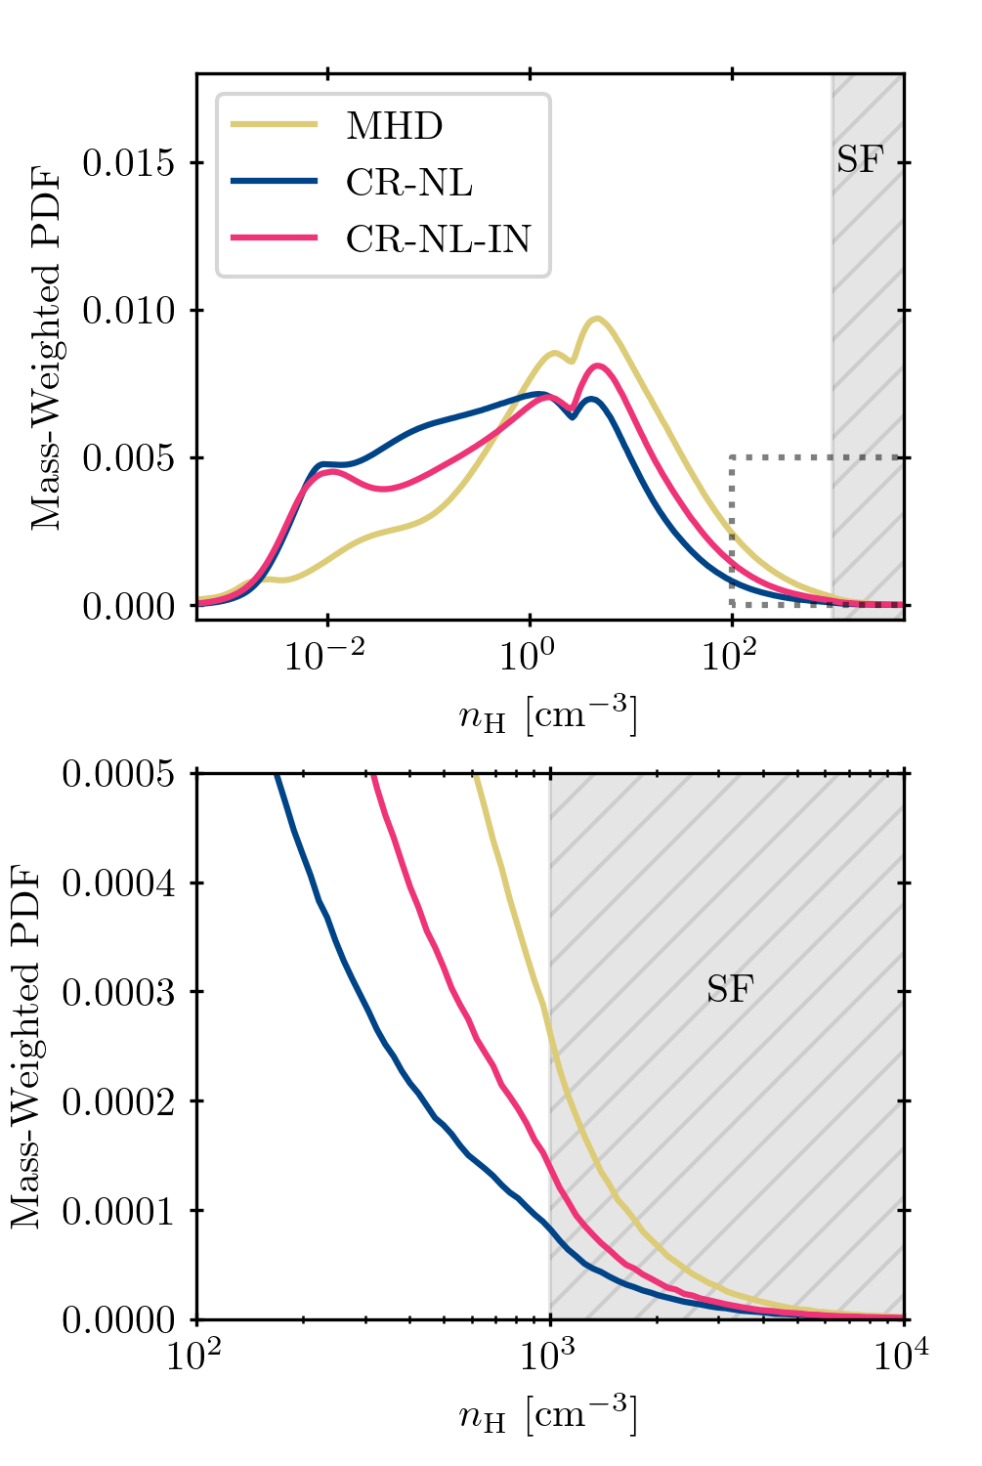
Star Forming Conditions
Trend in amount of star-forming gas here mirrors the SFRs from the previous slide.
CRs reduce the amount of star-forming gas.
IND decouples CRs from dense, neutral gas, allowing gas to reach star-forming densities with less resistance.
Add IND

Slide 23
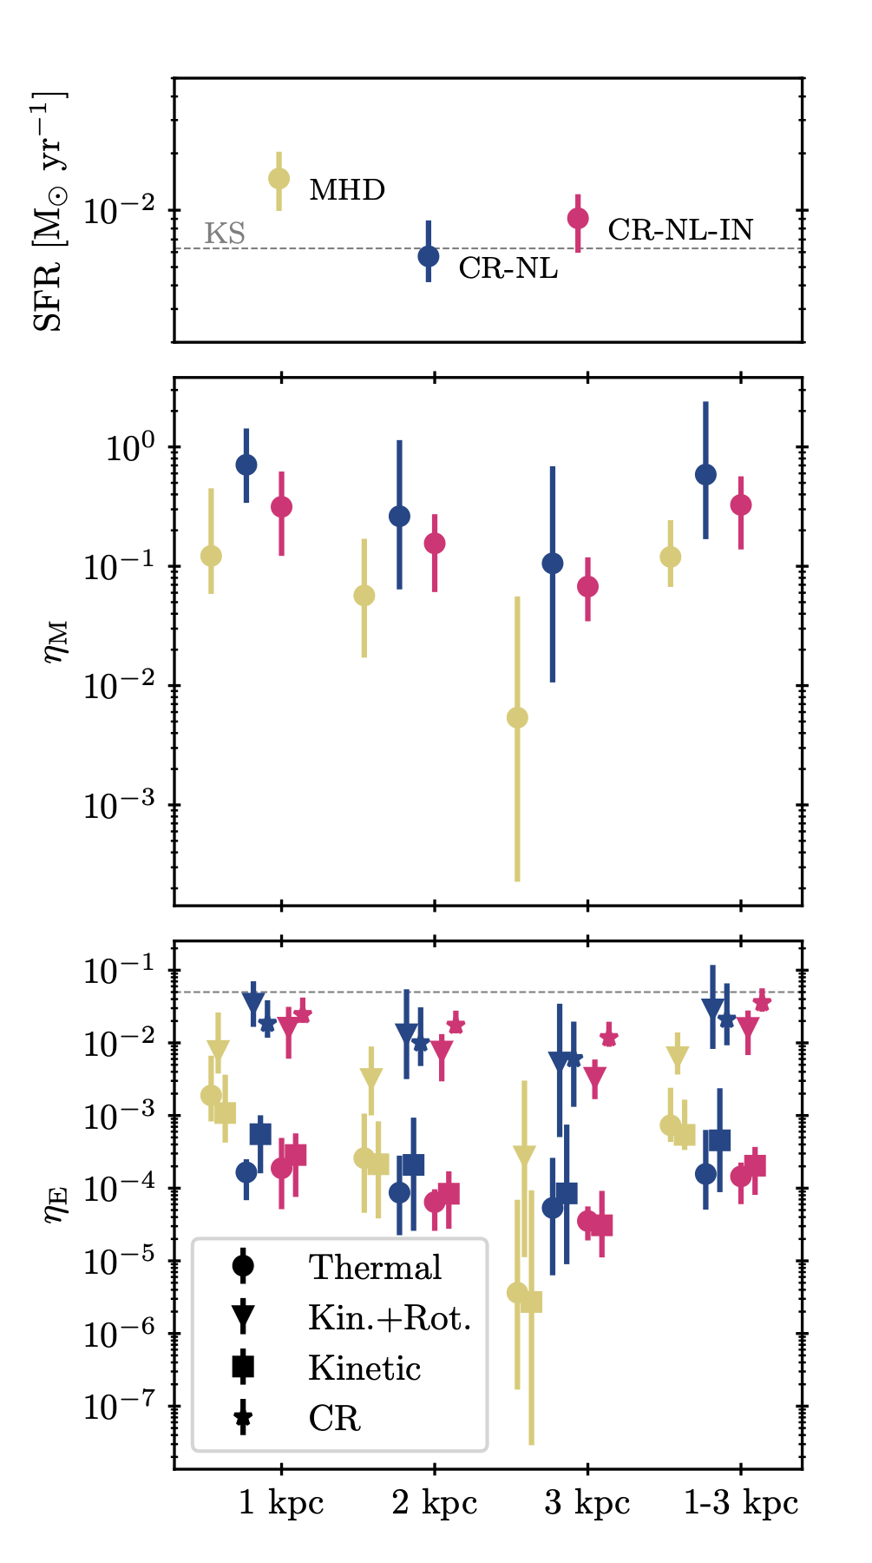
Outflow & Loading Factors
MHD case has the lowest mass-loading factors, and the outflow becomes very weak by |z|=3kpc.
SFRs are not different enough to explain the differences in mass loading factors.
CR-driven winds have high CR energy loading factors.

Slide 24
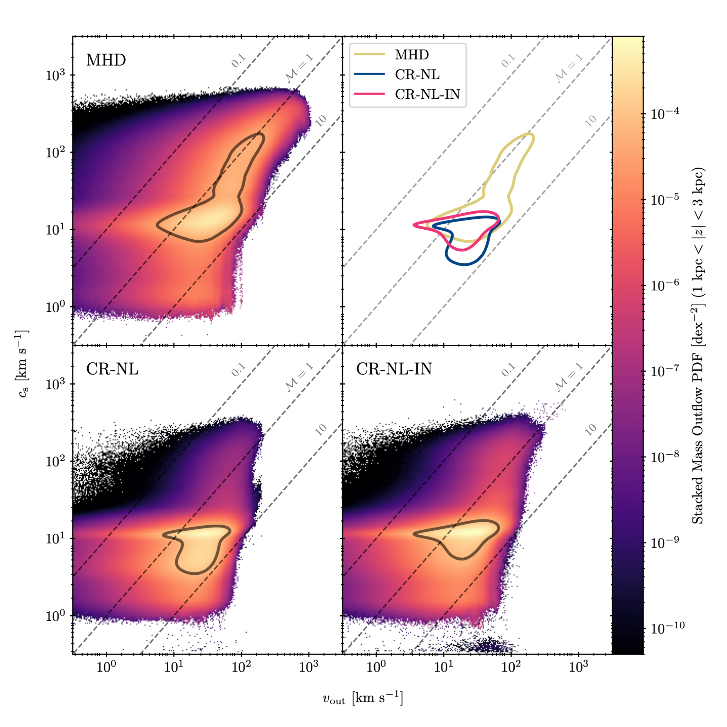
Outflow Phase
Pure MHD outflow is the hottest and the fastest, but with lowest Mach numbers.
CR-NL outflow is the coldest and has the highest Mach numbers.
CR-NL-IN is cool/warm with intermediate Mach numbers.

Slide 25
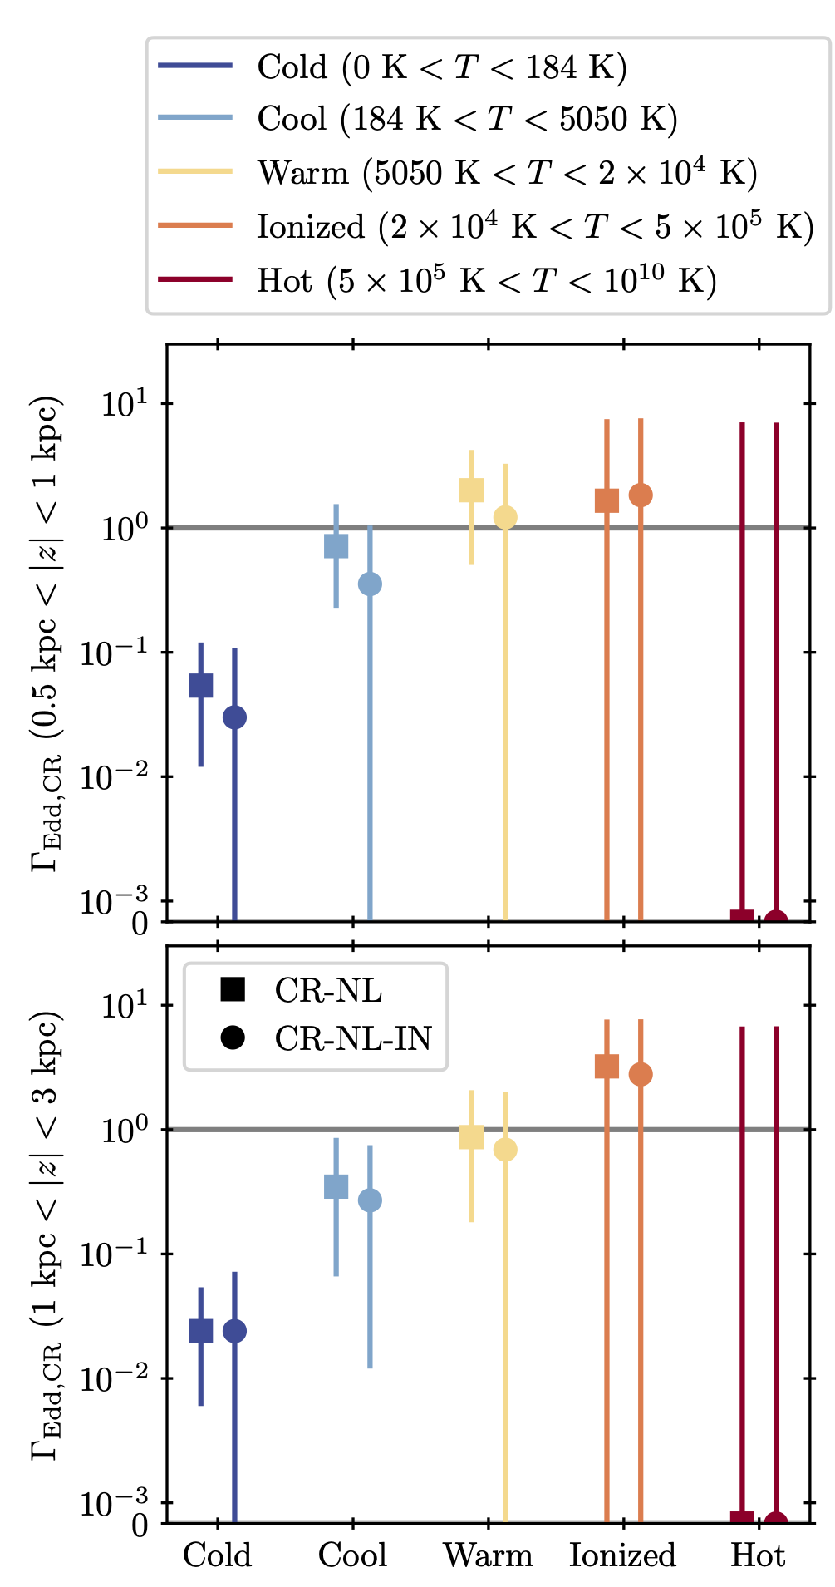
Driving Multiphase Outflows
CRs are best at accelerating warm & ionized gas, and bad at accelerating hot gas.
CRs provide little outward acceleration to cool and cold gas in the wind.
IND reduces the ability of CRs to accelerate gas, but not catastrophically.

Slide 26
In-Progress Work

Slide 27
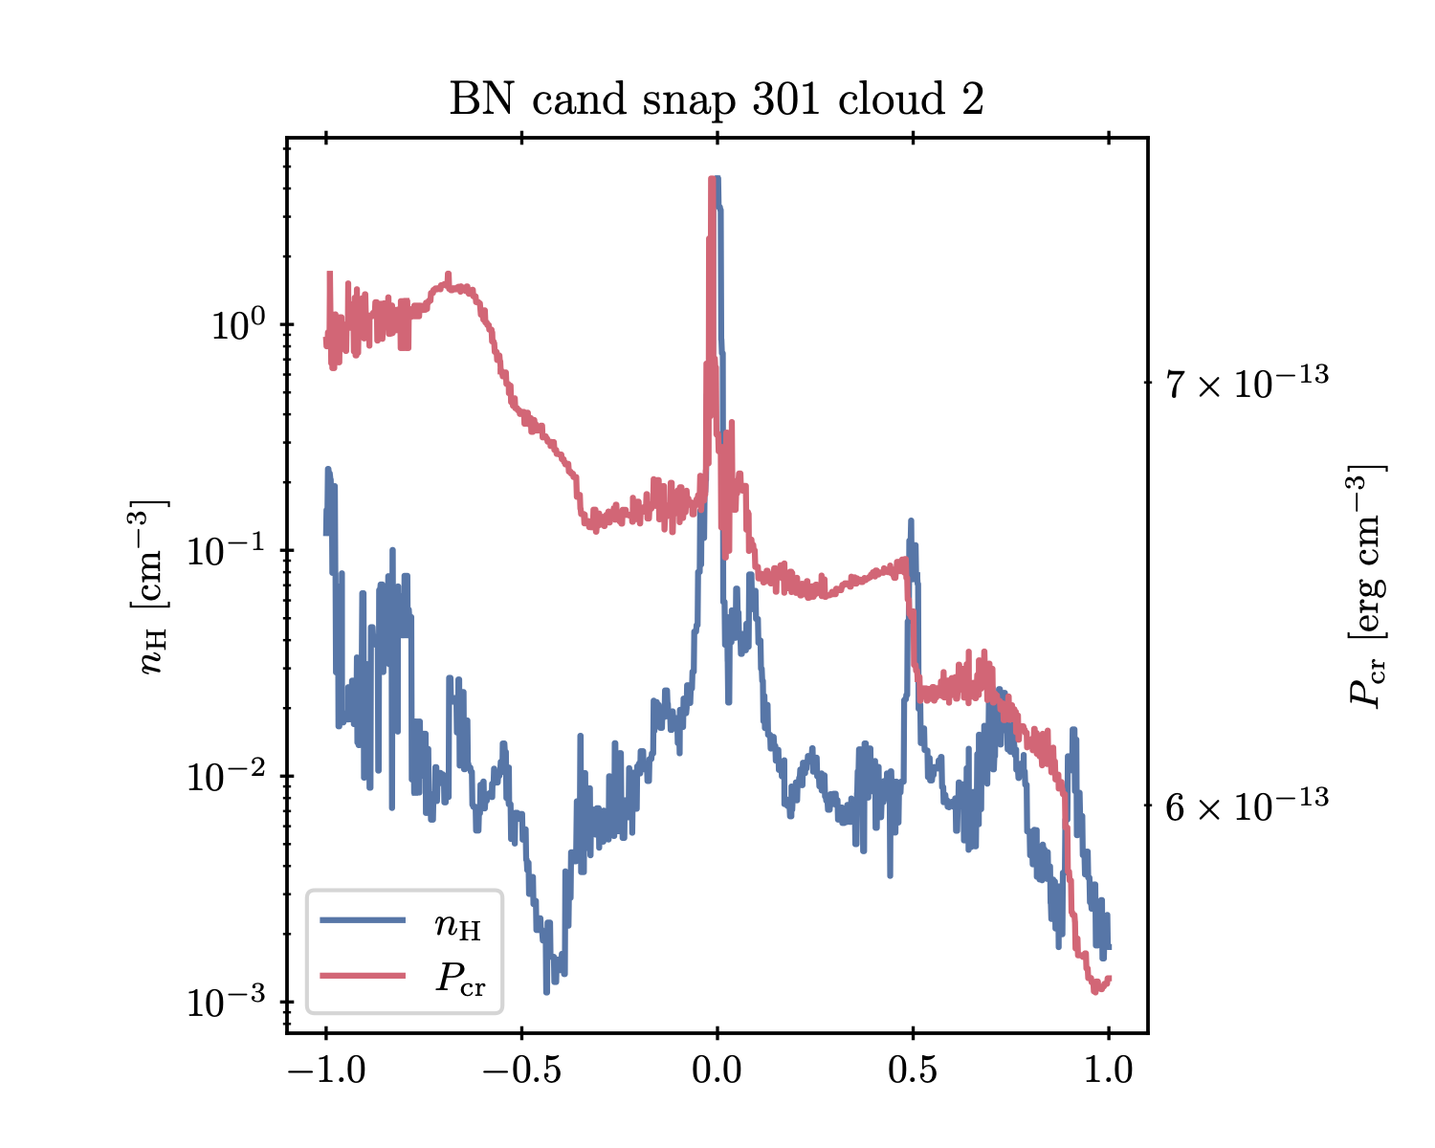
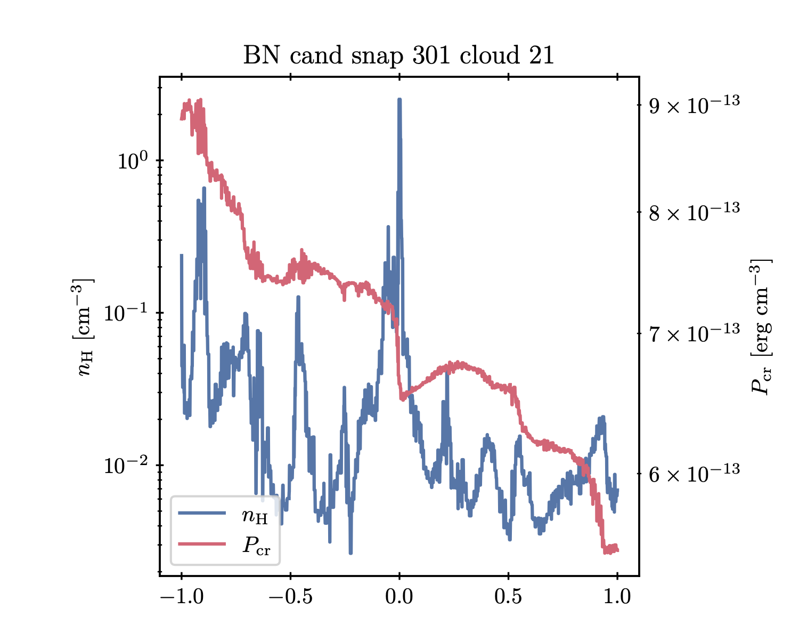
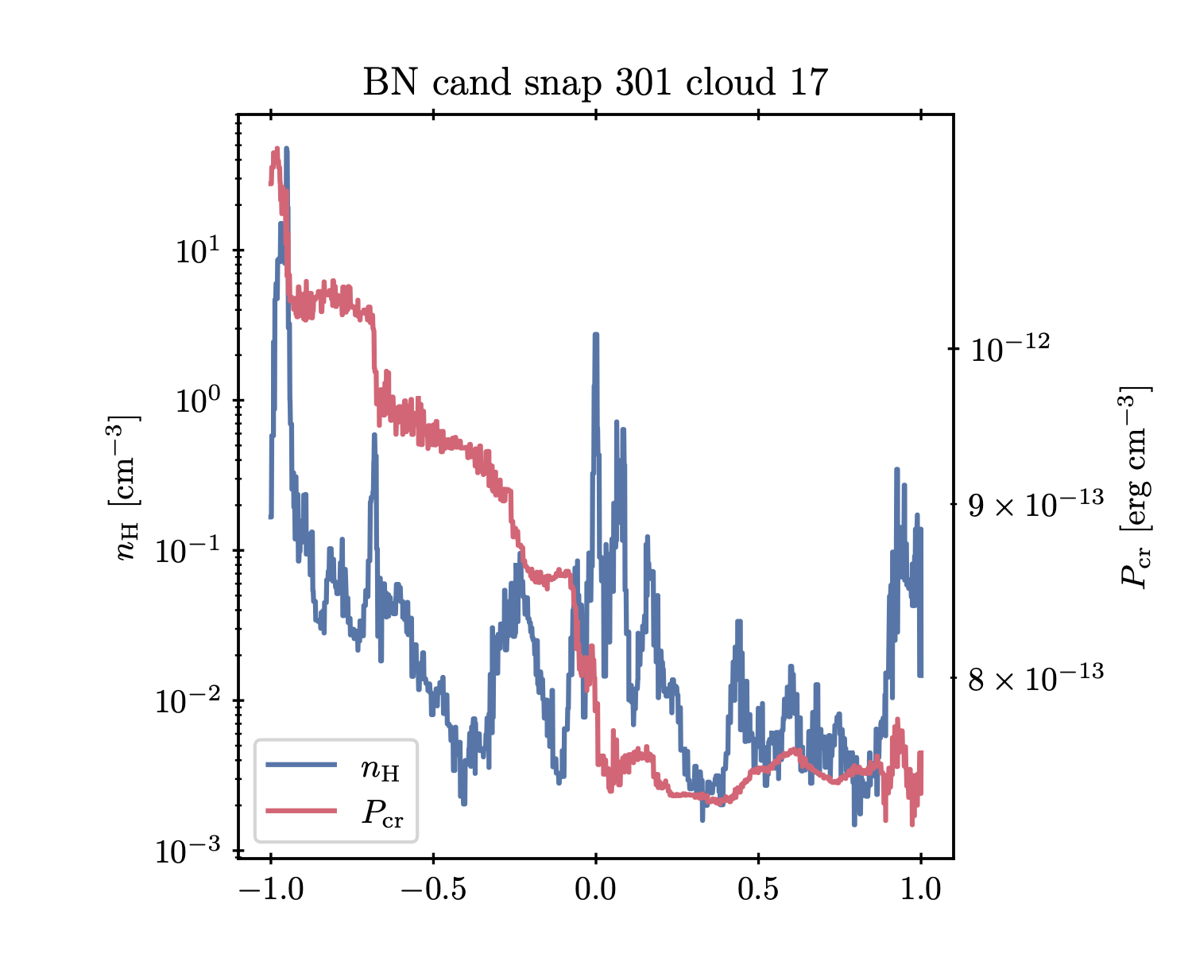
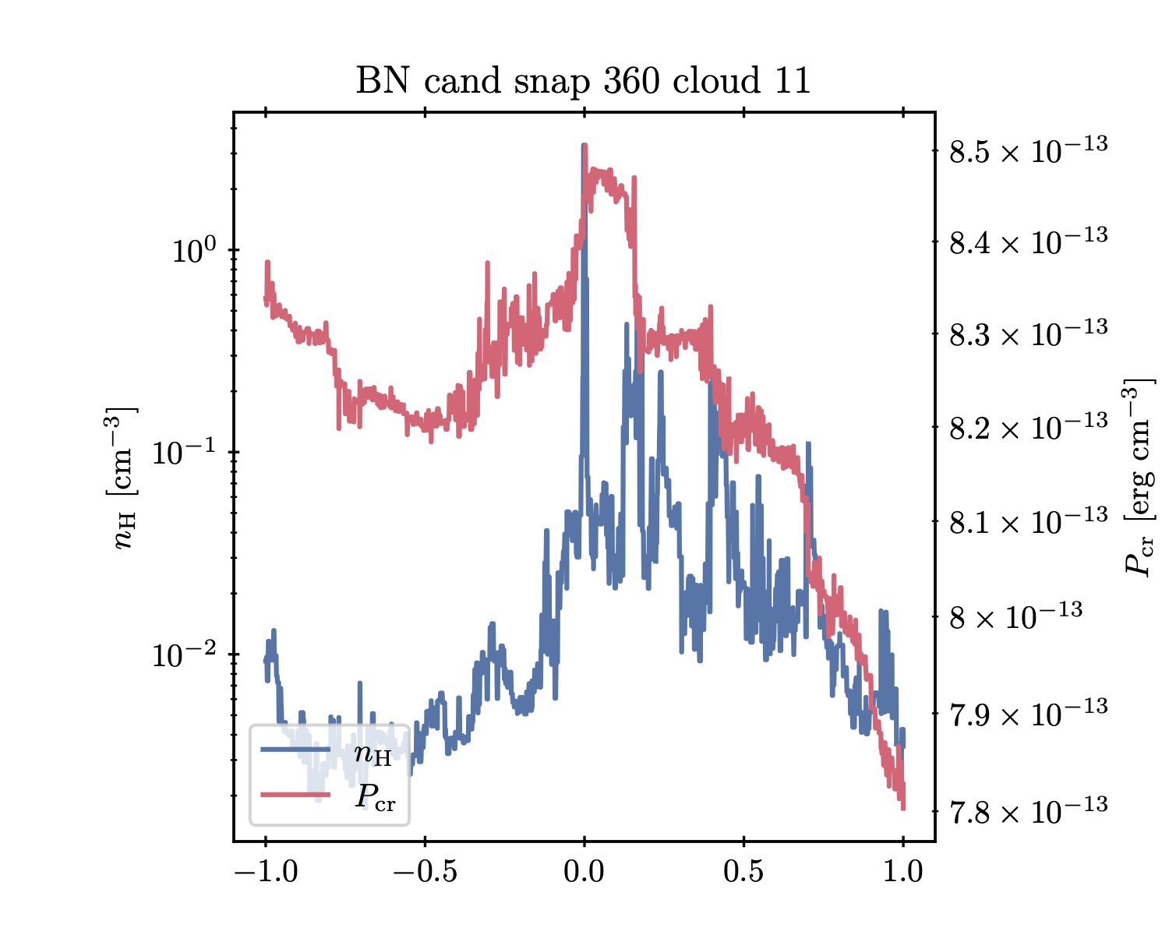
Cosmic Ray Bottlenecks
CR pressure becomes flat between density peaks (cold clouds).
CR pressure stairsteps at the cold clouds.
Consequence of self-confined transport.
Investigate observable properties, bottleneck demographics, and dynamical consequences (if any).

Slide 28
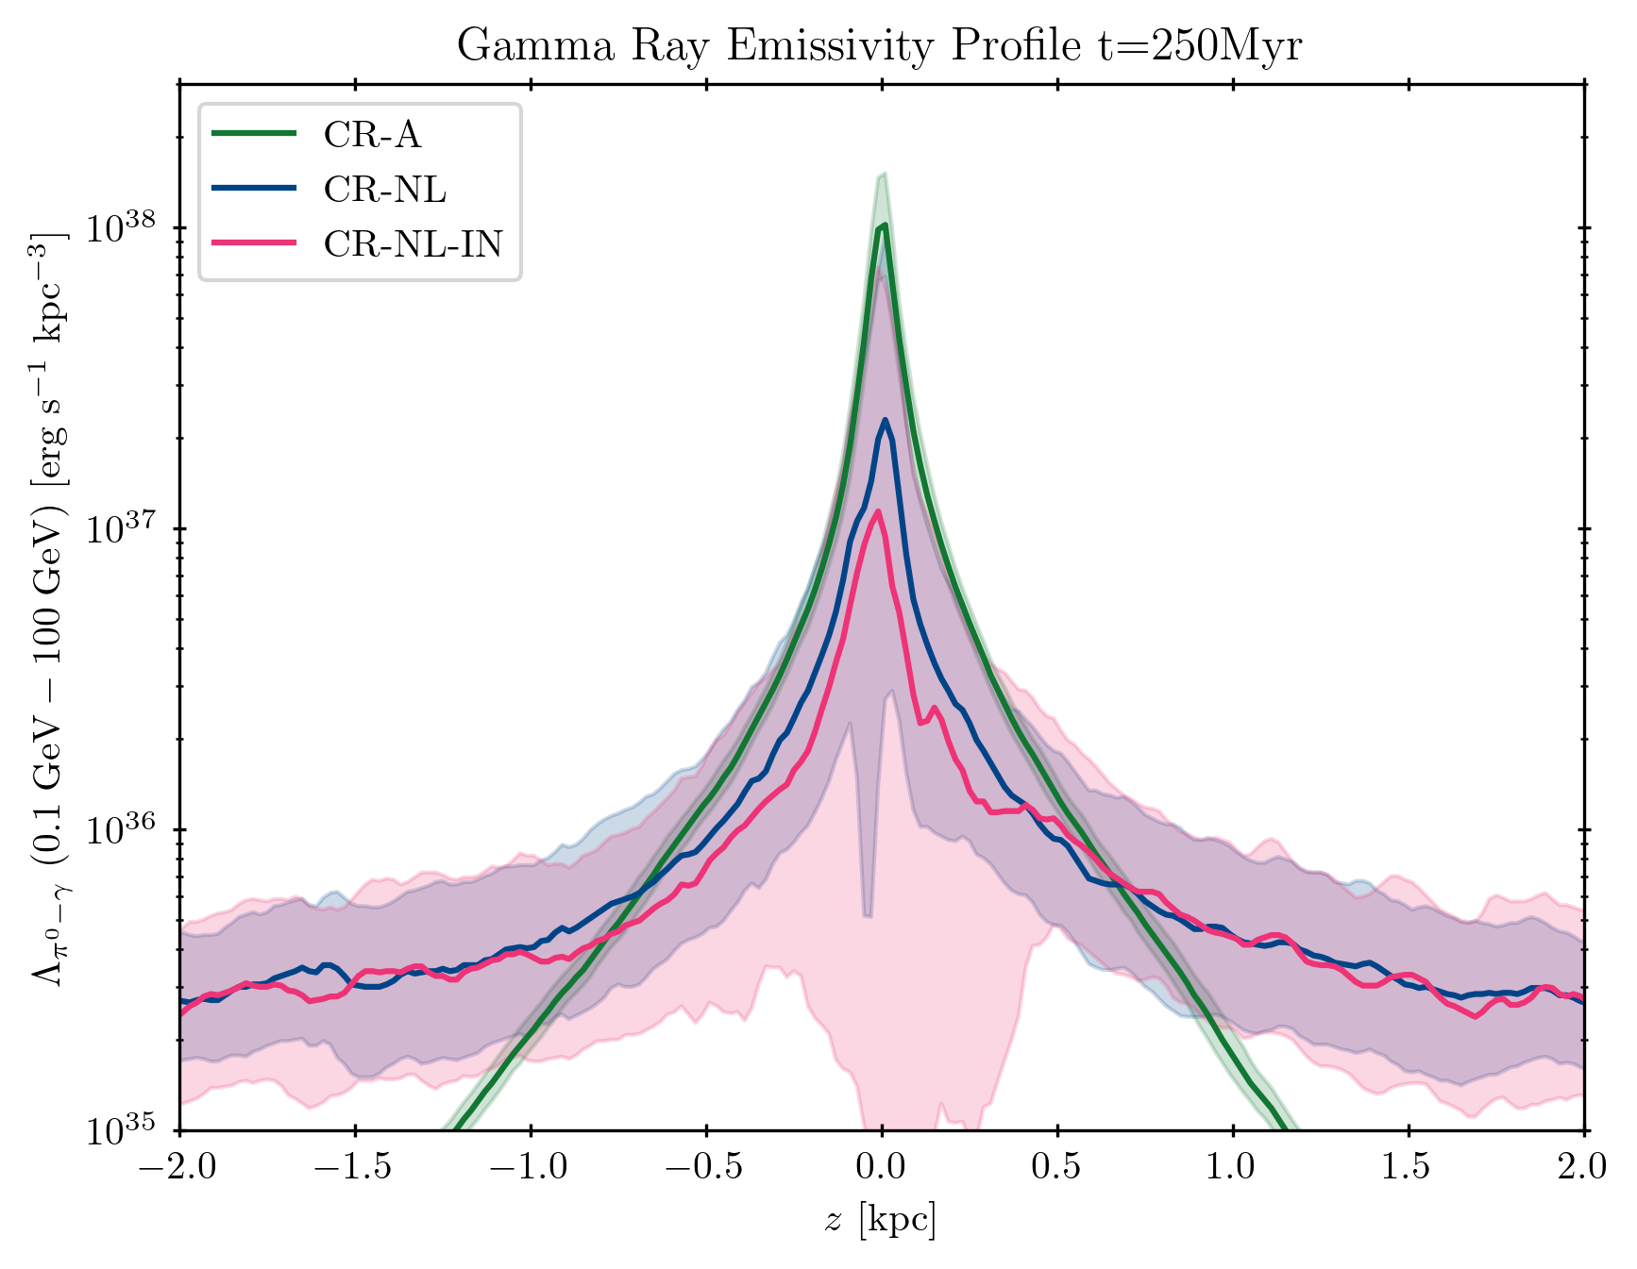
Gamma Rays and Calorimetry
IND decouples CRs from dense regions, implying decreased hadronic gamma ray emission.
Less gamma ray “losses” means more CRs available for wind-driving.
Investigate the effect of IND on gamma ray observables and CR proton calorimetry.

Slide 29
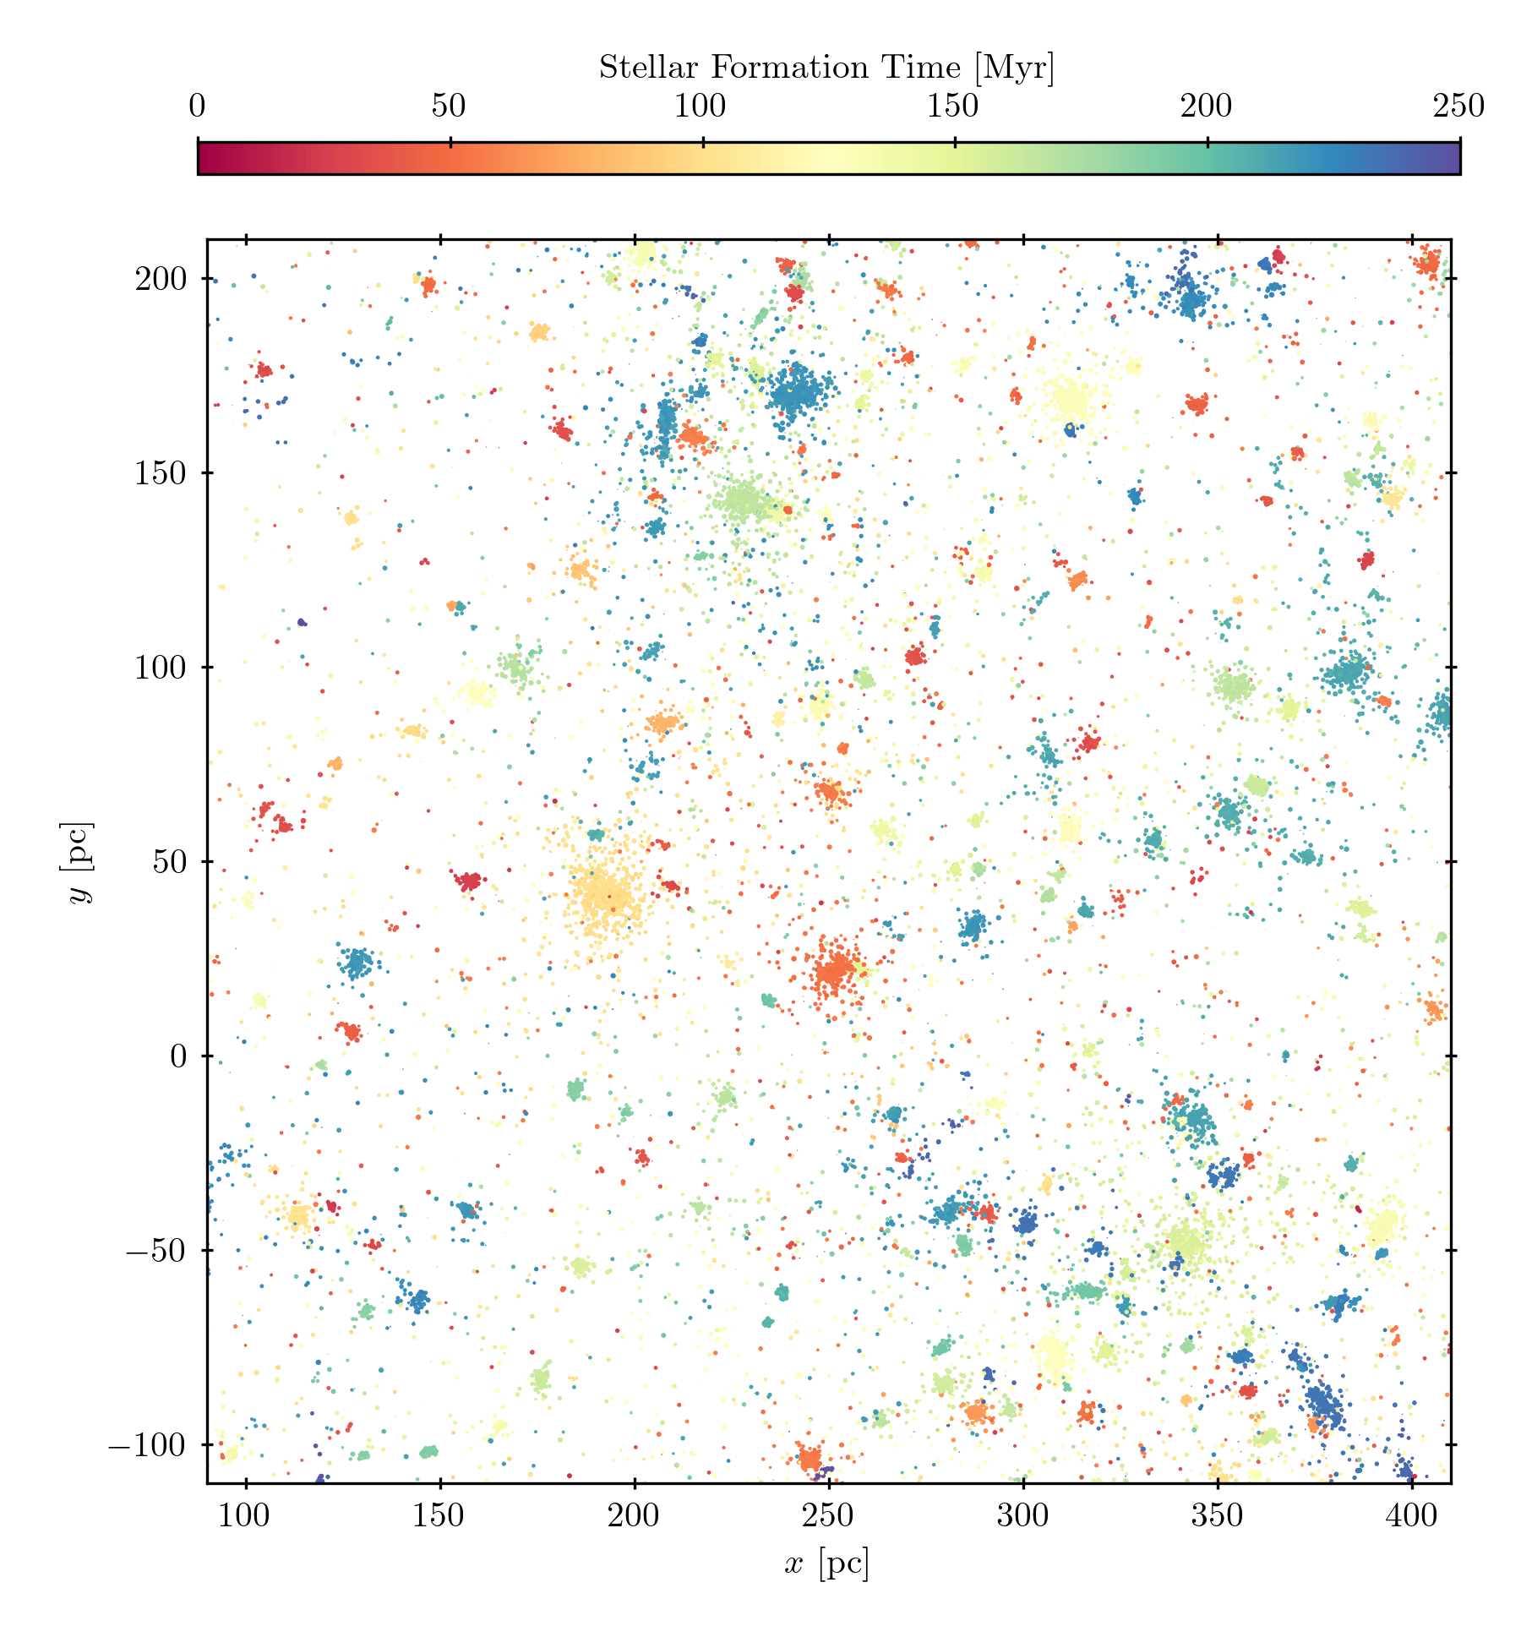
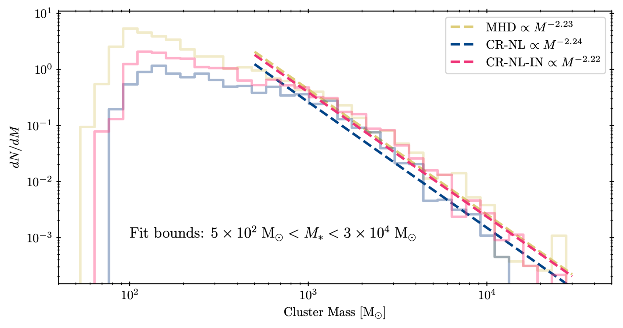
Star Clusters
Mass resolution allows us to form bound star clusters of particles with similar ages.
All models produce a similar (reasonable) mass function.
Investigate the effect of CRs on star cluster properties.

Slide 30
Summary
Ion-neutral damping does not prevent CRs from providing effective feedback.
Ion-neutral damping reduces the effect of CRs on the SFR.
Full-physics CR-driven wind is primarily warm with moderate mass loading and high CR energy loading.
Also bottlenecks, gamma rays, and star clusters.
See astro.brsike.com/tmex2025 for slides and contact info.

